Slide 1
Gradient Descent Review

Slide 2
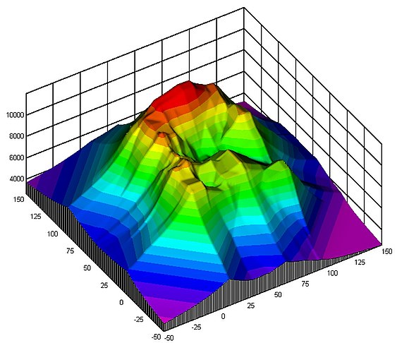
Descending in the Dark
Minimizing a loss function is like descending a mountain

Slide 3
Descending in the Dark
Minimizing a loss function is like descending a mountain
… in the dark

Slide 4
Descending in the Dark
Minimizing a loss function is like descending a mountain
… in the dark
Take a step in the steepest direction

Slide 5
Descending in the Dark
Minimizing a loss function is like descending a mountain
… in the dark
Take a step in the steepest direction
That’s following the gradient
Notes:
Metaphor is good because it helps us visualize what it’s like to do gradient descent.
The metaphor is bad because in many real machine learning applications, we’re not in 3 dimensional space.

Slide 6
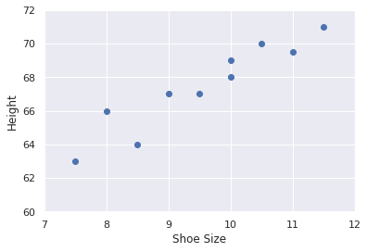
Procedure
Start with labeled data (inputs, outputs)

Slide 7
Procedure
Start with labeled data (inputs, outputs)
Linear Regression seeks to fit a line that minimizes loss
Notes:
[draw a line and loss computation]

Slide 8
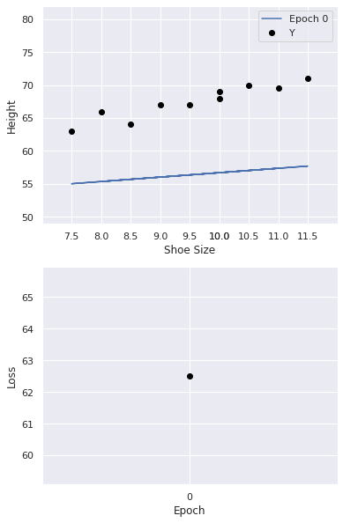
Procedure
Choose some initial parameter values (mapping of w0, w1)
Notes:
like w0=50, w1=0.7

Slide 9
Procedure
Use the model to make predictions
Compute the loss
Notes:
[draw predictions of the model]
[draw loss computation]

Slide 10
Procedure
Compute the gradient of the loss
This is a partial derivative for w0 and for w1
Notes:
This is what we derived last time. We compute a partial derivative for each variable separately, then assemble them into a vector.
[d/dw0, d/dw1]

Slide 11
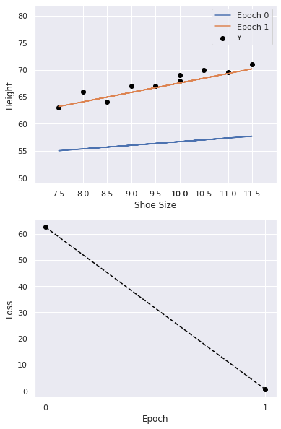
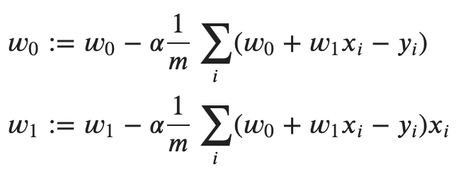
Procedure
Update w0 and w1
Notes:
The partial derivatives tell us which direction we should go (up/down) and how big a step we should take.

Slide 12
Procedure
Update w0 and w1
Learning Rate
Notes:
Because we err on the side of caution, we find it best to take smaller steps, so we scale the gradient by a learning rate.
Remember last time, we tried computing the loss for a whole bunch of different parameter values, slowly filling in the shape of the whole loss curve.
Gradient descent helps us get to the optimum much faster.

Slide 13
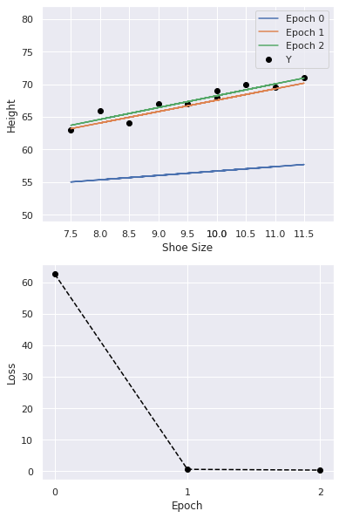
Procedure
Repeat!

Slide 14
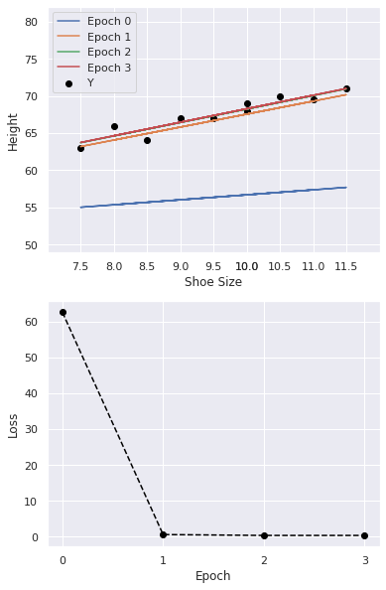
Procedure
Repeat!
… until convergence
Notes:
What does convergence mean? The difference in weights gets very small.
Why do I keep going through gradient descent? It’s really the key ML algorithm and it’s hard to understand the first time around.
Also, we’re going to start thinking about much higher dimensional data and these prediction functions and loss functions won’t be possible to visualize.
So this is one last chance to see everything before the idea of gradient descent gets somewhat more abstract.

Slide 15
Gradient Descent Review
Notes:
Q: The learning rate is typically
(a) less than 1
(b) greater than 1
(c) equal to 1
A: (a)

Slide 16
Multivariate Regression
Notes:
As promised, let’s start to make things more interesting by talking about the general regression case with more than a single feature.

Slide 17
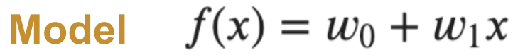
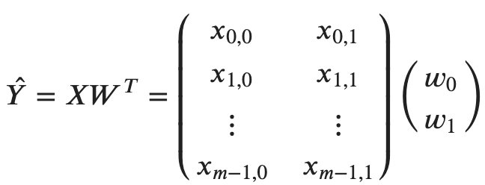
Matrix Representation
Notes:
So here’s our old familiar single-variable (single feature) model.
Let’s express the prediction function as a matrix multiplication
[m data points in a batch]
[x_i,j refers to row i, column j]

Slide 18
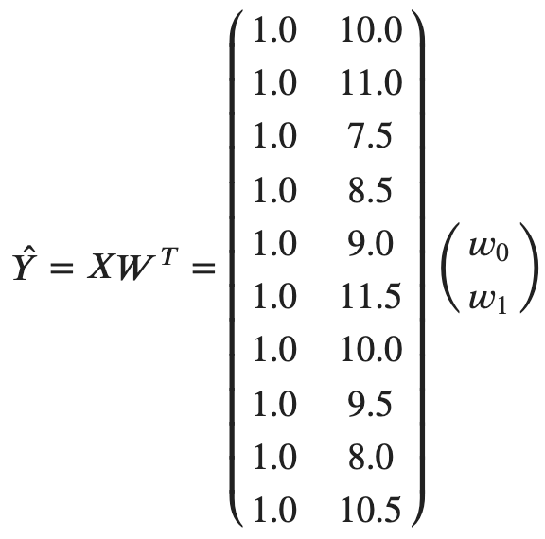
Single Feature
Notes:
Here’s what this actually looks like for our shoe size data on the right.

Slide 19
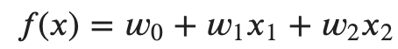
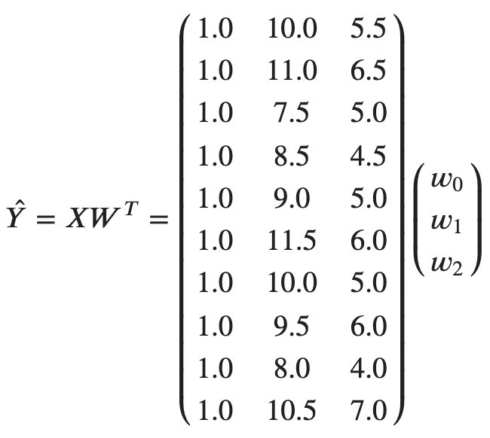
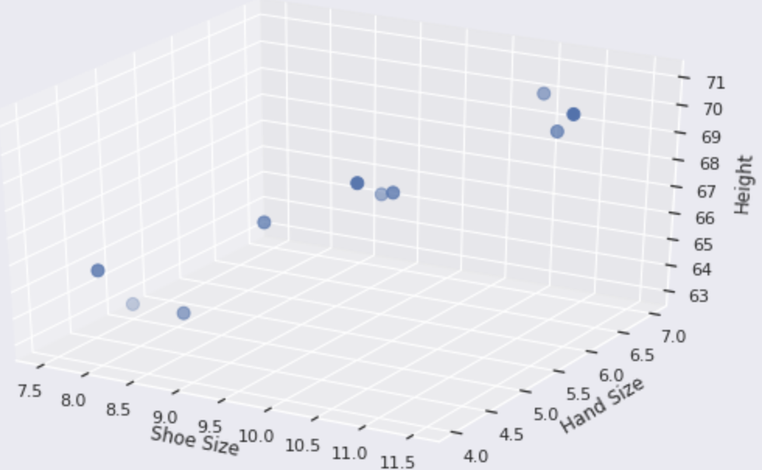
Two Features

Slide 20
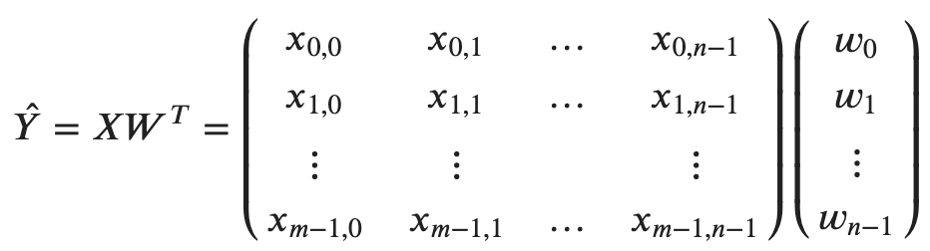
N Features
Notes:
[m data point] [n features]

Slide 21

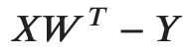
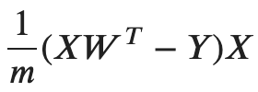
Gradient Descent (again)
Predictions
Differences
Gradient

Slide 22
Multivariate Regression
Notes:
Q: With n features and m training examples, the shape of the gradient should be
(a) (m, n)
(b) (m, 1)
(c) (n, 1)
A: (b)

Slide 23
Features Overview

Slide 24
Model Diagram
Data
Input
Function
Output
x
f(x)
y

Slide 25

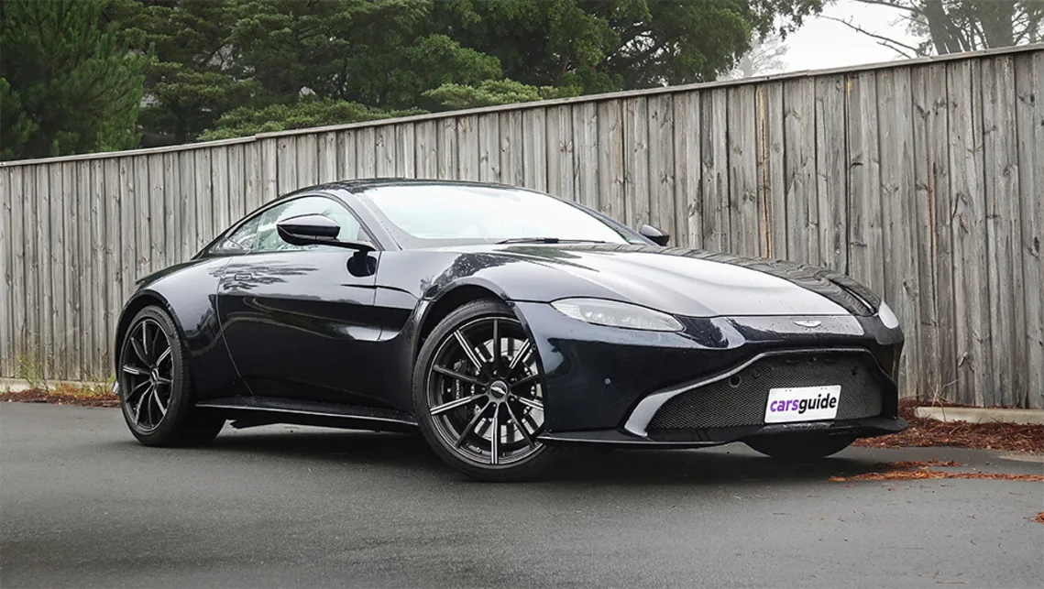
Car Features
Data
Input
Function
x
f(x)
Notes:
Let’s think again about the specific problem of predicting the price of a car.
The key first step is to decide how to decompose a car into a set of features that describe it.
Crucially, these features need to be common to all cars so that our predictions can generalize.

Slide 26
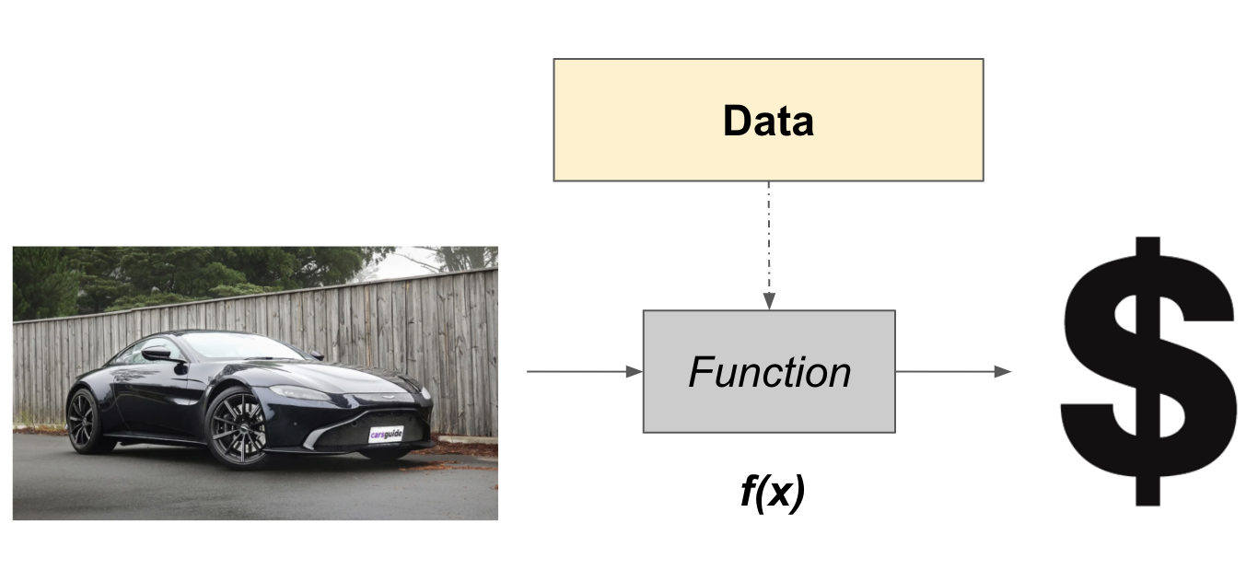
Car Features
Horsepower
Number of seats
Year
Four-wheel drive
Image
Description
Acceleration sound
Notes:
Here are some possible features we could use.

Slide 27
Feature Engineering
0: {
info: {
make: toyota
model: camry
year: 2014
horsepower: 224
seats: 5
all wheel drive: no
}
description-text:
a mid-size family sedan
...
}
Raw Data
Notes:
So before we can make use of these car descriptors in a model, we need to do some engineering work to convert them into the right format.
In particular, our regression model only works with numeric inputs.

Slide 28
Feature Engineering
0: {
info: {
make: toyota
model: camry
year: 2014
horsepower: 224
seats: 5
all wheel drive: no
}
description-text:
a mid-size family sedan
...
}
[
224.0
5.0
1.0
0.0
1.0
…
]
Feature Vector
Raw Data
Notes:
We typically refer to the initial data as ‘raw data’ and the usable numerical data as a feature vector.
Remember our matrix representation of regression? An example of a car is converted to a feature vector, which is a row of our data matrix X.

Slide 29
Feature Engineering
0: {
info: {
make: toyota
model: camry
year: 2014
horsepower: 224
seats: 5
all wheel drive: no
}
description-text:
a mid-size family sedan
...
}
[
224.0
5.0
1.0
0.0
1.0
…
]
Feature Engineering
Feature Vector
Raw Data
Notes:
This manipulation of raw data into feature vectors is called feature engineering.

Slide 30
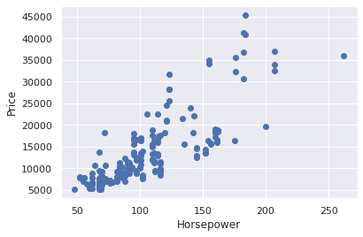
Feature Examples
Horsepower
Number of seats
Year
Four-wheel drive
Image
Description
Acceleration sound

Slide 31
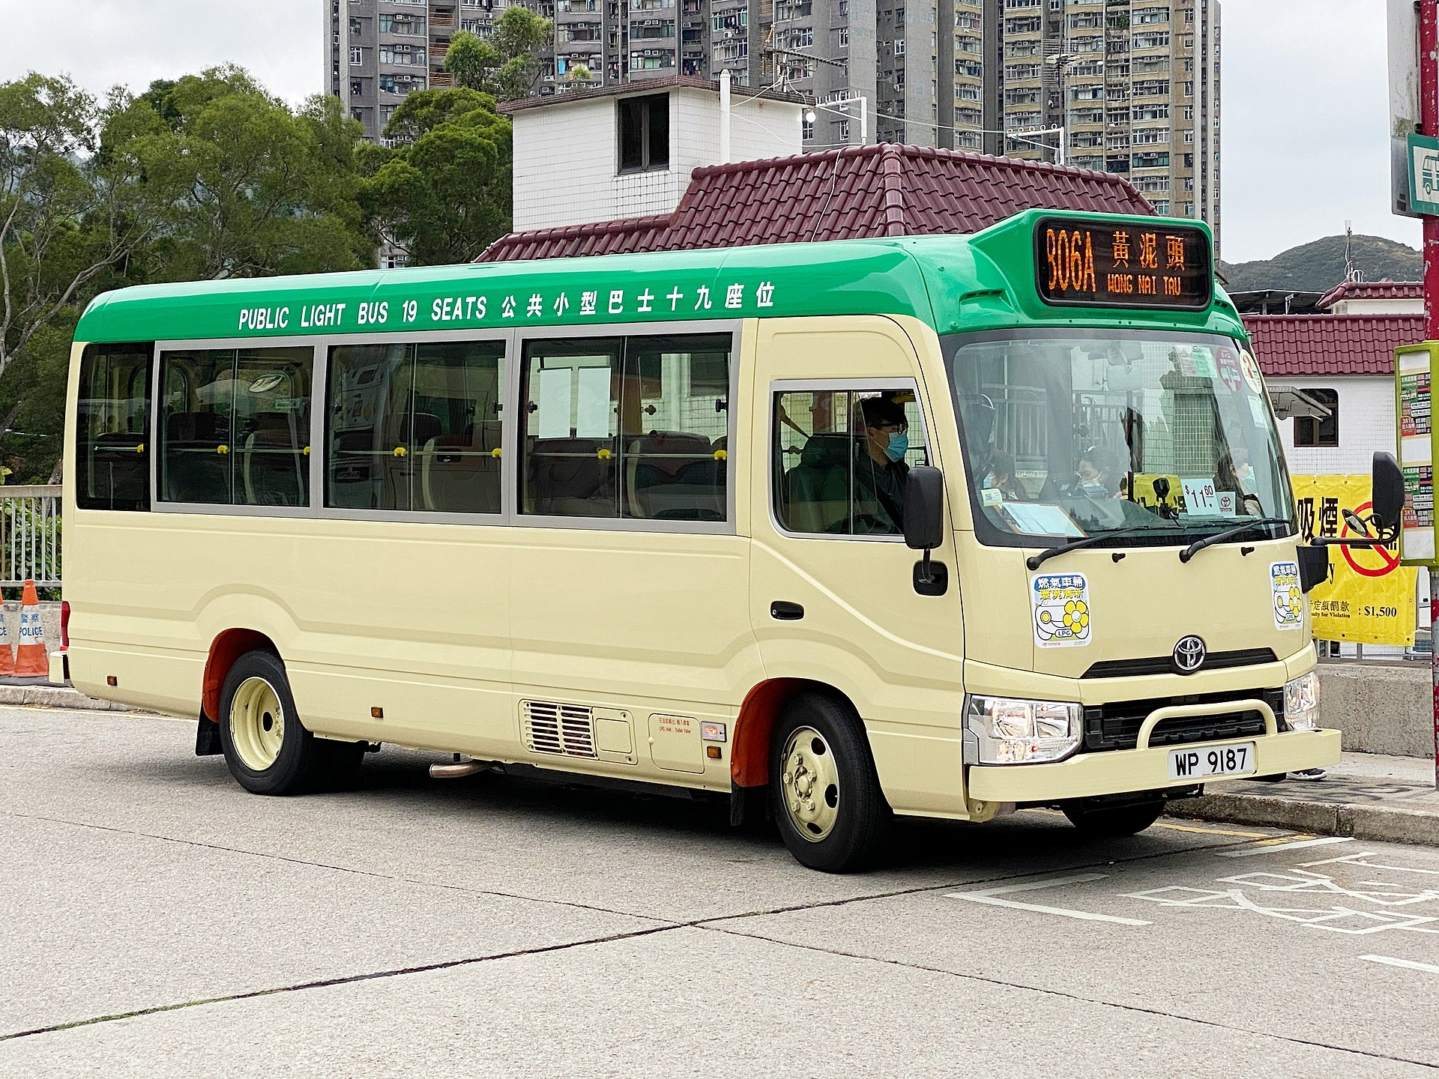
Feature Examples
Horsepower
Number of seats
Year
Four-wheel drive
Image
Description
Acceleration sound
[source]

Slide 32
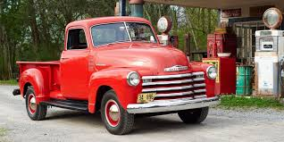
Feature Examples
Horsepower
Number of seats
Year
Four-wheel drive
Image
Description
Acceleration sound
[source]

Slide 33
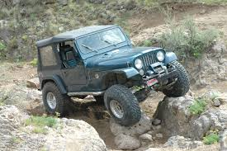
Feature Examples
Horsepower
Number of seats
Year
Four-wheel drive
Image
Description
Acceleration sound
[source]

Slide 34
Feature Examples
Horsepower
Number of seats
Year
Four-wheel drive
Image
Description
Acceleration sound

Slide 35

Feature Examples
Horsepower
Number of seats
Year
Four-wheel drive
Image
Description
Acceleration sound
Overview. Beneath the 2020 Alfa Romeo Giulia's seductive sheetmetal lies a sharp-handling sports sedan with Italian heritage.

Slide 36

Feature Examples
Horsepower
Number of seats
Year
Four-wheel drive
Image
Description
Acceleration sound
[source]

Slide 37
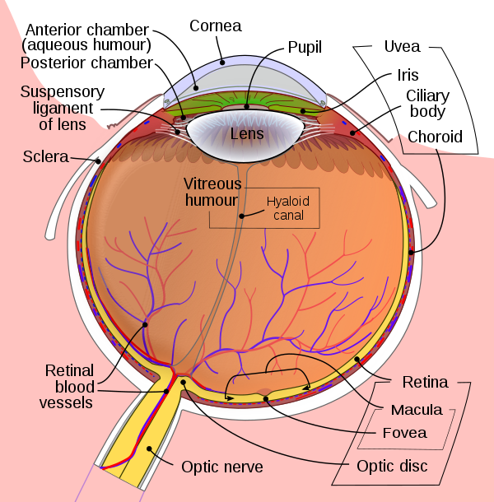
Feature Engineering
Notes:
We can look to our own evolved systems for examples of the kinds of software components we’re trying to build.
Roughly speaking, a human eye performs some feature engineering.
The raw data is light at various frequencies and intensities, entering the eye.
I’m not a biologist so I won’t try to explain how all these components work together, but the rods and cones in the retina detect different frequencies and emit electrical signals down the optic nerve for further processing in the brain.

Slide 38
Feature Engineering
Clean raw data
Handle missing values, outliers

Slide 39
Feature Engineering
Clean raw data
Handle missing values, outliers
Produce numeric features
Convert categories, text, images, audio
Transform to similar scales

Slide 40
Feature Engineering
Clean raw data
Handle missing values, outliers
Produce numeric features
Convert categories, text, images, audio
Transform to similar scales
Combine to form new features

Slide 41
Feature Engineering
Clean raw data
Handle missing values, outliers
Produce numeric features
Convert categories, text, images, audio
Transform to similar scales
Combine to form new features
Keep only useful features

Slide 42
Features Overview
Notes:
Q: [True/False] Linear regression requires numeric inputs.
A: True

Slide 43
Feature Engineering I

Slide 44
Goals
Predict price as accurately as possible
for cars you haven’t seen before
Using numeric features
you can feed to a model
A minimal set of features
is more efficient
and easier to interpret

Slide 45
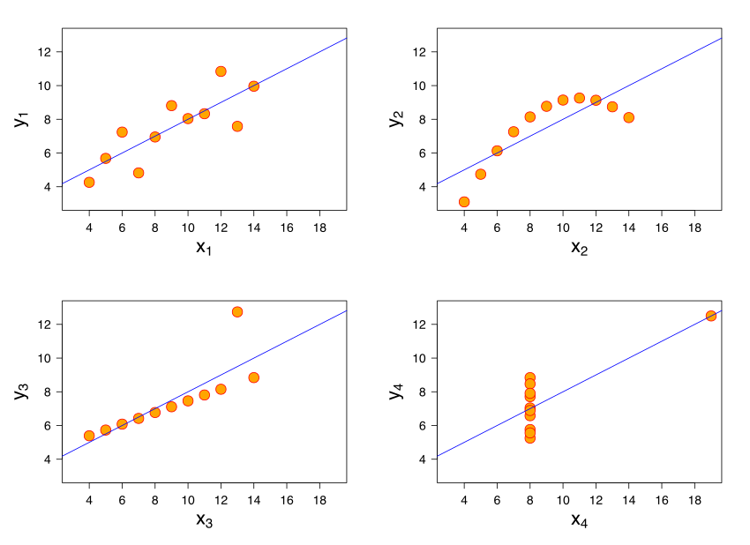
Anscombe’s Quartet
Notes:
Before getting into more detail, let’s pause note that when we have a lot of features available, it’s tempting to dump them all into a model and call it a day.
This is like claiming that the job of a carpenter is just to hammer nails. In the same way a carpenter needs to use the right tools in accordance with a high level project vision, you need to be very familiar with your features and how your model will combine them.
The statistician Francis Anscombe constructed this quartet of examples to show why summary statistics like mean, variance, or correlation are poor substitutes for visualization of data.

Slide 46
Missing Features
Raw data can be missing information
Remove rows with a missing value
Replace missing values with an average
or a special “missing” value
Make | Horsepower | Seats | Year
Ford | 250 | 4 | --
-- | -- | 6 | 1996
BMW | 275 | -- | 2000

Slide 47
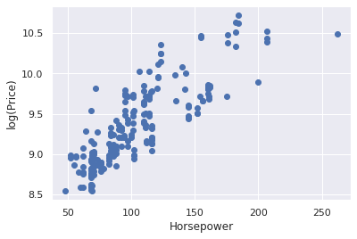
Transforming Features
Linear regression assumes linear relationships

Slide 48
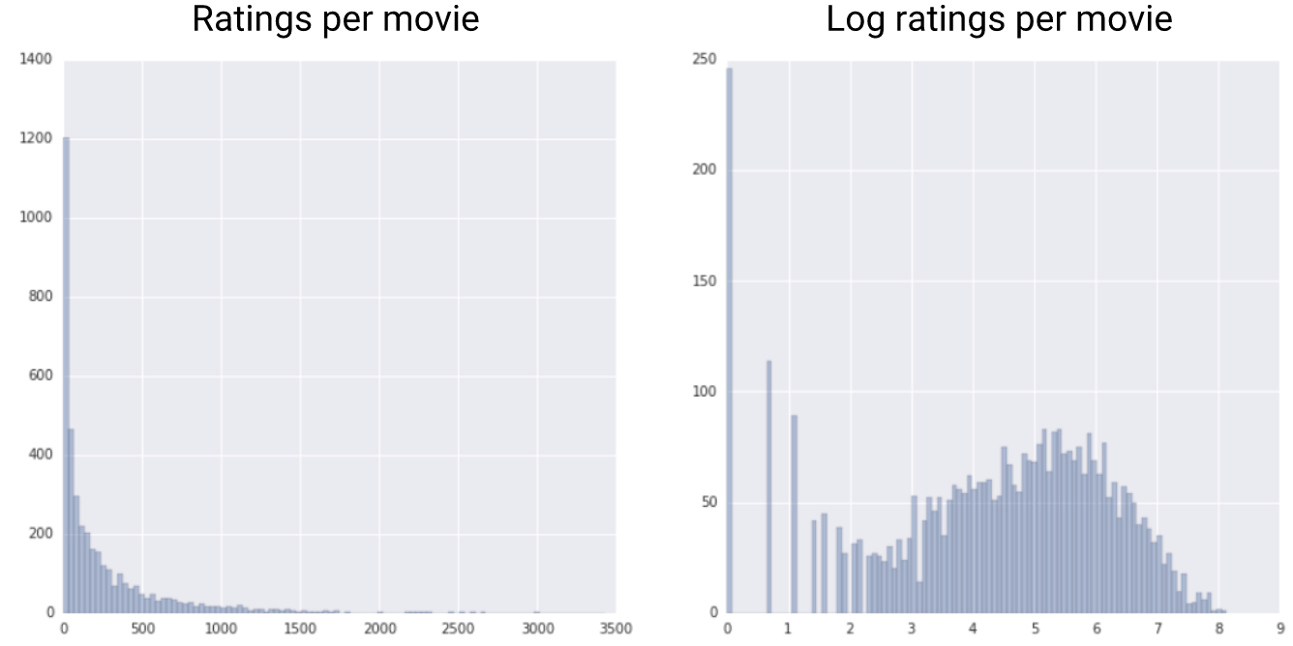
Log Scaling
Many natural distributions are exponential
Like popularity
Lots of ratings for the head
Few ratings for the tail

Slide 49
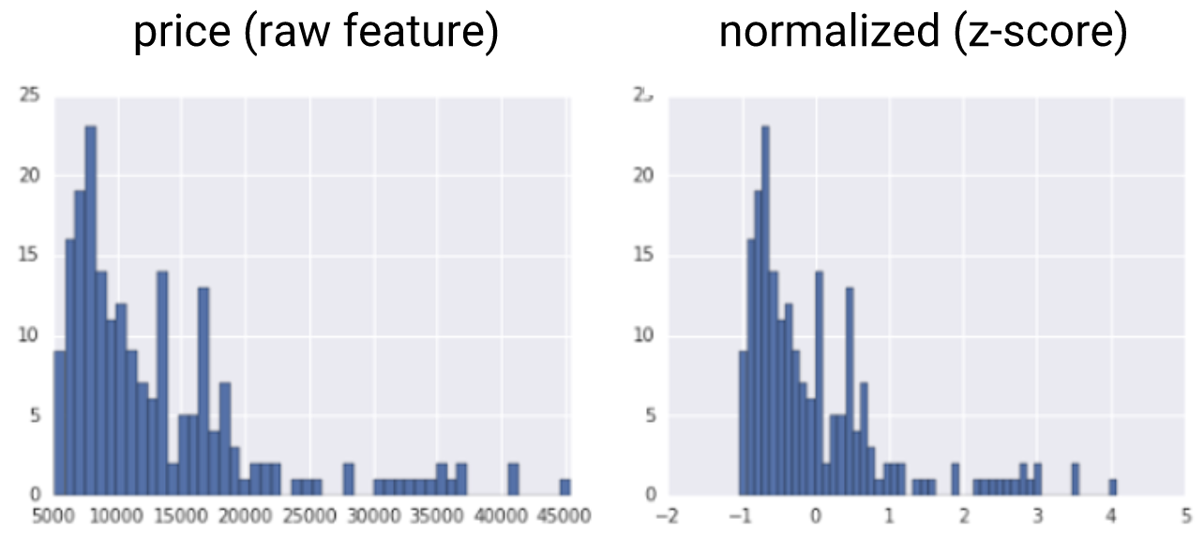
Z-Score Scaling
Move distribution to have mean=0, variance=1
Subtract the mean
Divide by the standard deviation

Slide 50
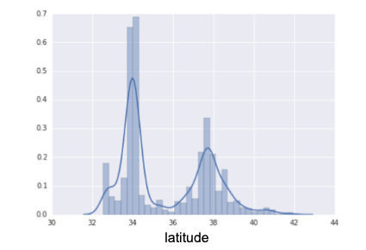
Bucketing
Some distributions are more complex (multimodal)

Slide 51
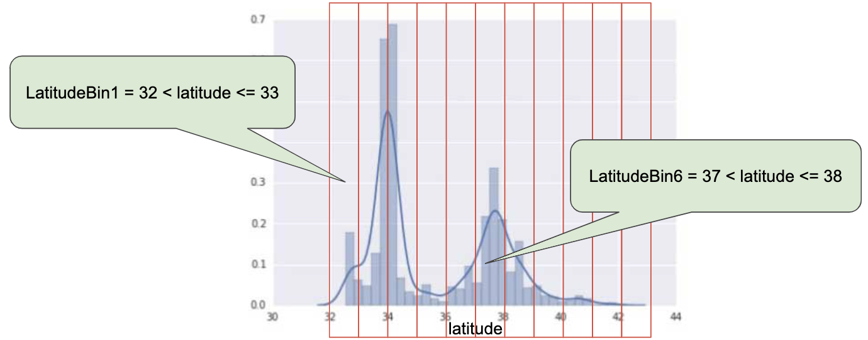
Bucketing
Some distributions are more complex (multimodal)

Slide 52
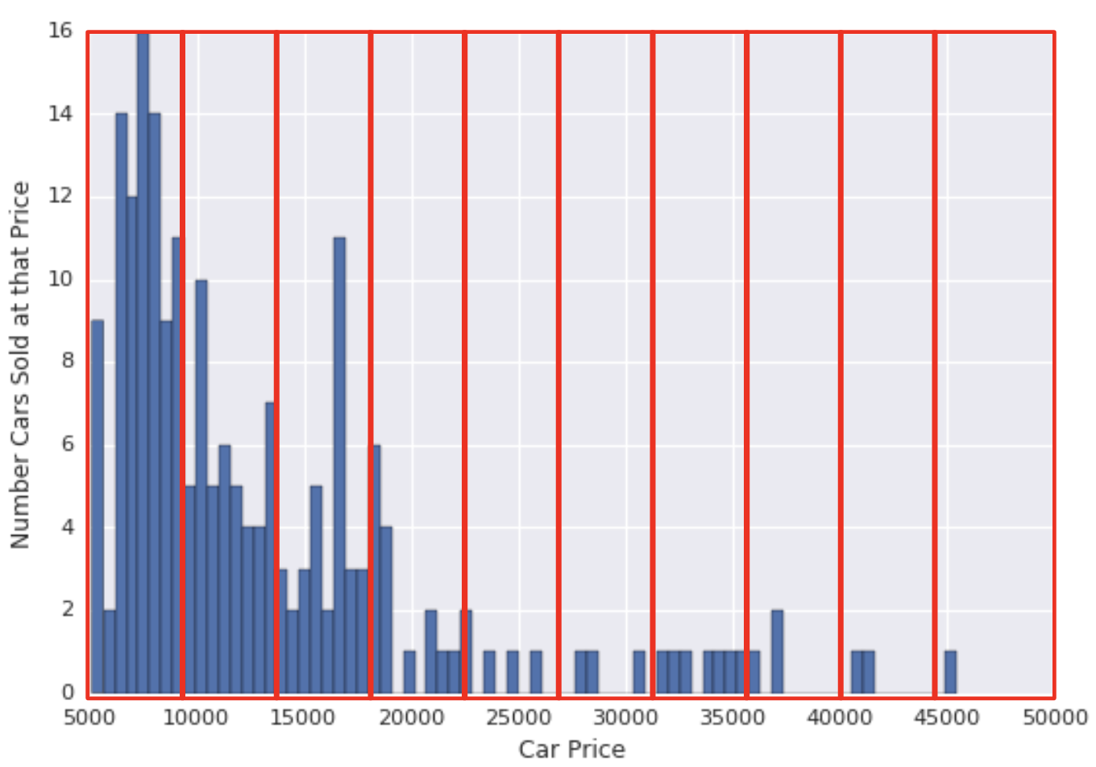
Bucketing - Even Spacing

Slide 53
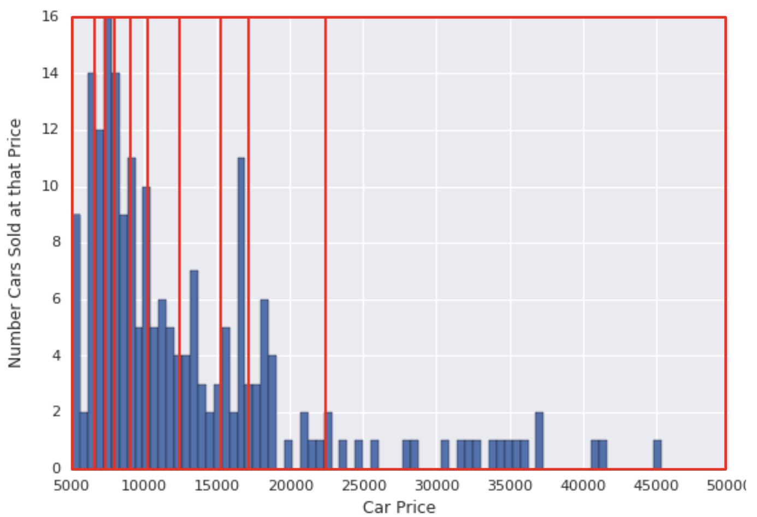
Bucketing -- Quantiles

Slide 54
Categorical Features
“All-wheel drive” [true, false]
[1]

Slide 55
Categorical Features
“All-wheel drive” [true, false]
[1]
Indicator

Slide 56
Categorical Features
“All-wheel drive” [true, false]
“Color” [black, white, red]
“Make” [ford, bmw, audi, honda]
[1]
[0,1,0]
[0,0,0,1]

Slide 57
Categorical Features
“All-wheel drive” [true, false]
“Color” [black, white, red]
“Make” [ford, bmw, audi, honda]
[1]
[0,1,0]
[0,0,0,1]
One-hot vector

Slide 58
Categorical Features
“All-wheel drive” [true, false]
“Color” [black, white, red]
“Make” [ford, bmw, audi, honda]
[1]
[0,1,0]
[0,0,0,1]
One-hot vector
Multi-hot vector
Dense Representation
[1,0,1,0,0,0,0,1]

Slide 59
Categorical Features
“All-wheel drive” [true, false]
“Color” [black, white, red]
“Make” [ford, bmw, audi, honda]
[1]
[0,1,0]
[0,0,0,1]
One-hot vector
Multi-hot vector
Dense Representation
Sparse Representation
[1,0,1,0,0,0,0,1]
[0,2,7]

Slide 60
Feature Vector
Dense Representation
[1,1,0,1,0,0,0,0,1]

Slide 61
Feature Vector
Dense Representation
[1,1,0,1,0,0,0,0,1]
Vocab
0 BIAS
1 AWD
2 Black
3 White
4 Red
5 Ford
6 BMW
7 Audi
8 Honda

Slide 62
Feature Vector
Dense Representation
[1,1,0,1,0,0,0,0,1]
Vocab
0 BIAS
1 AWD
2 Black
3 White
4 Red
5 Ford
6 BMW
7 Audi
8 Honda
How many parameters for linear regression?

Slide 63
Feature Vector
Dense Representation
[1,1,0,1,0,0,0,0,1]
Vocab
0 BIAS
1 AWD
2 Black
3 White
4 Red
5 Ford
6 BMW
7 Audi
8 Honda
How many parameters for linear regression?
What does it mean if w1 = 0?

Slide 64
Feature Vector
Dense Representation
[1,1,0,1,0,0,0,0,1]
Vocab
0 BIAS
1 AWD
2 Black
3 White
4 Red
5 Ford
6 BMW
7 Audi
8 Honda
How many parameters for linear regression?
What does it mean if w1 = 0?
What does it mean if w2 > w3?

Slide 65
Feature Engineering I
Notes:
Q: [True/False] A categorical feature with 10 possible values produces a one-hot representation with 10 features.
A: True

Slide 66
Feature Engineering II

Slide 67
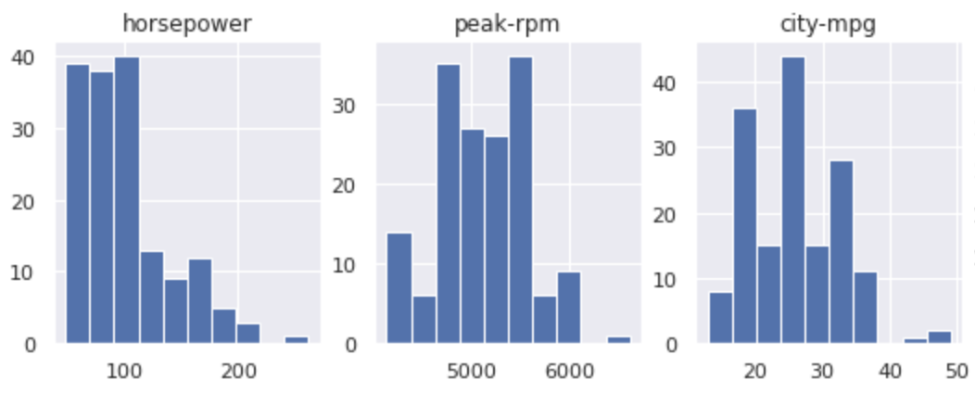
Feature Scaling
Suppose each feature has a different scale

Slide 68
Feature Scaling
Suppose each feature has a different scale
What of the gradient?

Slide 69
Feature Crosses
Consider the relationships
HP vs Price
Seats vs Price
(HP x Seats) vs Price

Slide 70
Feature Crosses
Consider the relationships
HP vs Price
Seats vs Price
(HP x Seats) vs Price
Add non-linear relationships to a linear model

Slide 71
Feature Selection
Remember we want a parsimonious model
With only useful features
Bottom-up: add features one at a time
Top-down: remove features one at a time

Slide 72
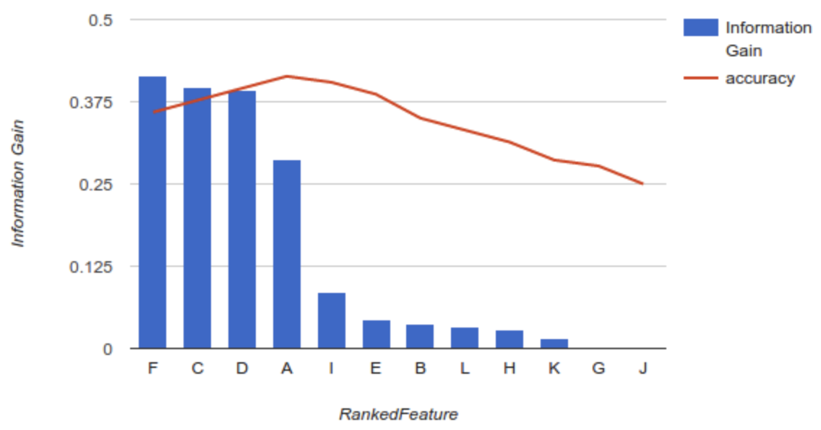
Feature Selection
Remember we want a parsimonious model
With only useful features
Bottom-up: add features one at a time
Top-down: remove features one at a time

Slide 73
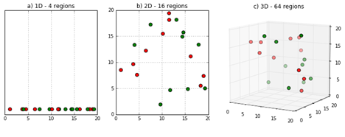
Curse of Dimensionality
Examples with 2 features are easy to visualize
Size of the space grows exponentially
[source]

Slide 74
Feature Engineering Advice
More features requires more data
Visualize your data
Start with a baseline, add complexity only if necessary
Analyze errors for intuition about missing information

Slide 75
Feature Engineering II
Notes:
Q: [True/False] Z-Score scaling can significantly improve training convergence speed.
A: True

Slide 76
Case Study: Used Cars

Slide 77


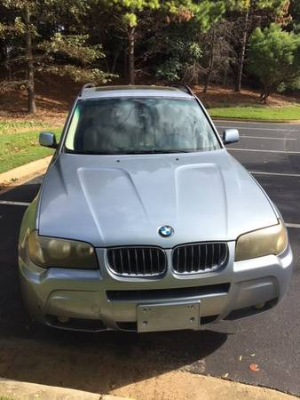
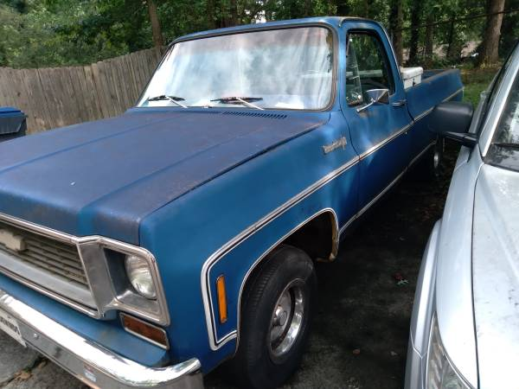
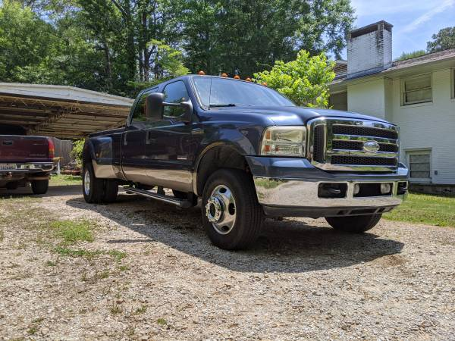
Used Car Price Prediction
~450M listings scraped from Craigslist (data on Kaggle)
26 possible features including list price
More realistic pricing than Kelly Blue Book?
[source]

Slide 78
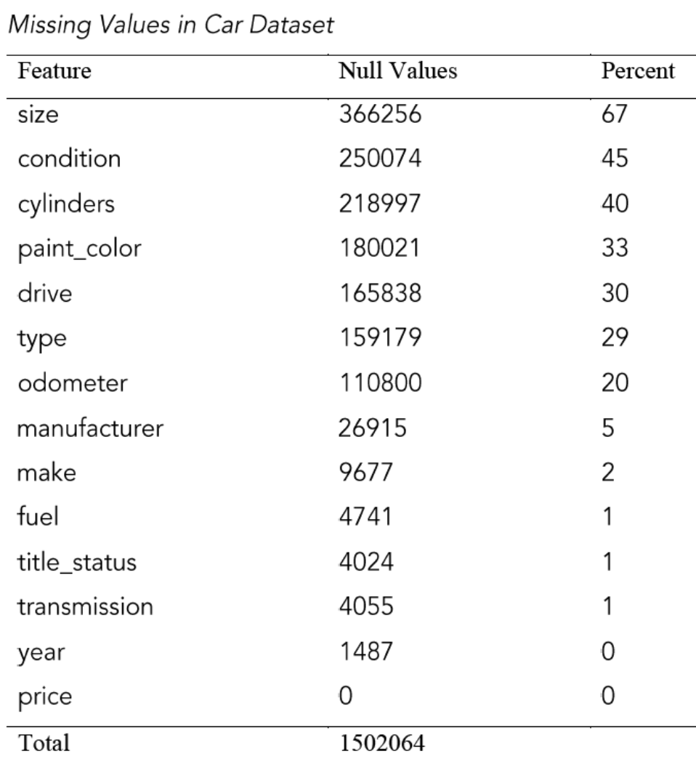
Missing Values
Throw out some features
Image, Lat/Long, VIN
Drop cars with extreme values
$100 > Price > $100k
Impute some missing values
Recent year -> condition=new

Slide 79
Feature Engineering
Convert categorical to numerical
Values scaled to [0,1]
0.0
0.5
1.0
5000
52500
100000

Slide 80
Train/Test Split
Randomly choose 80% of examples for training, 20% for testing
Remember, the goal is to predict prices for cars in the test set

Slide 81
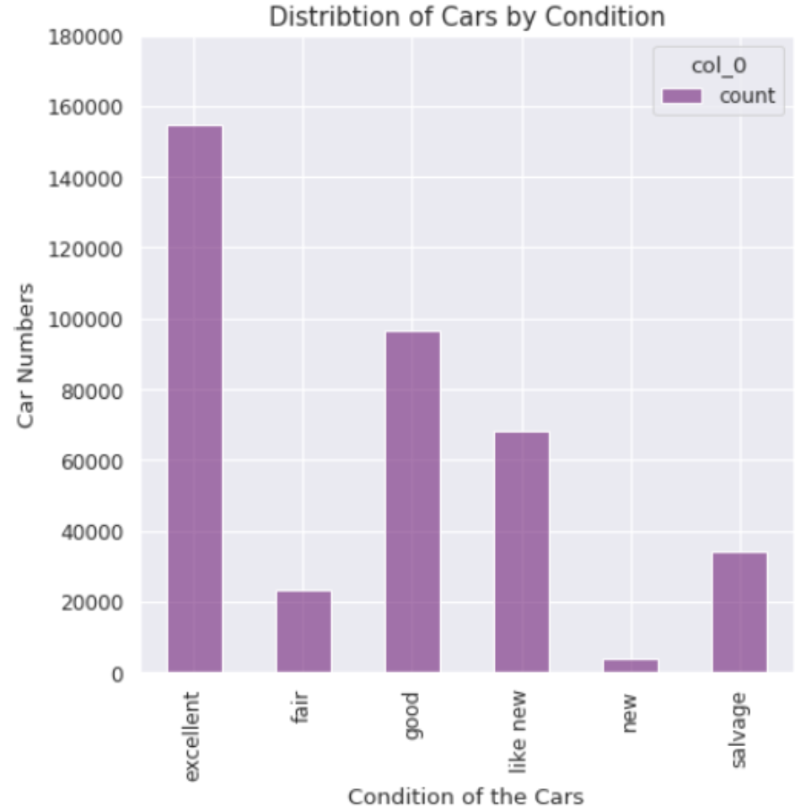
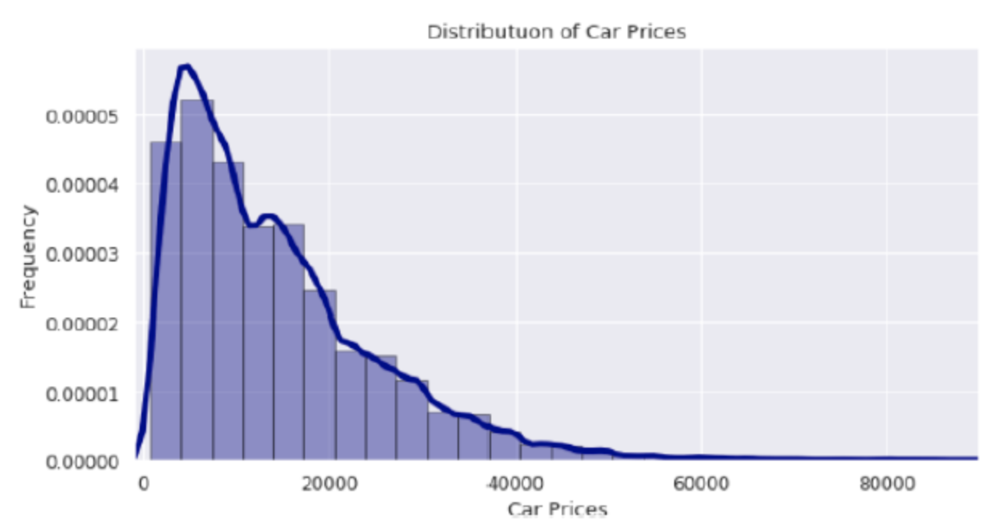
Visualize Distributions

Slide 82
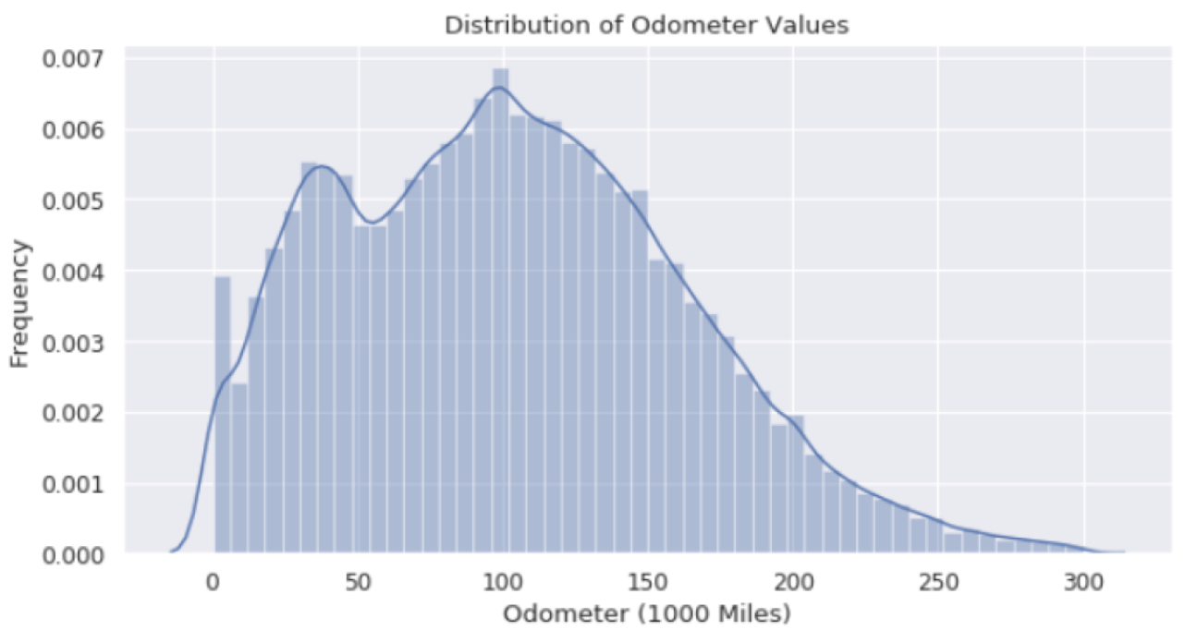
Visualize Distributions

Slide 83
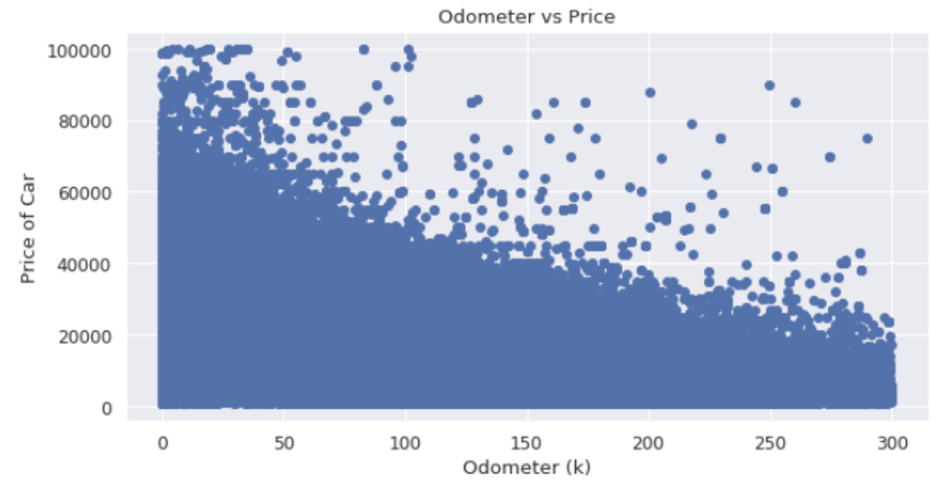
Visualize Relationships

Slide 84
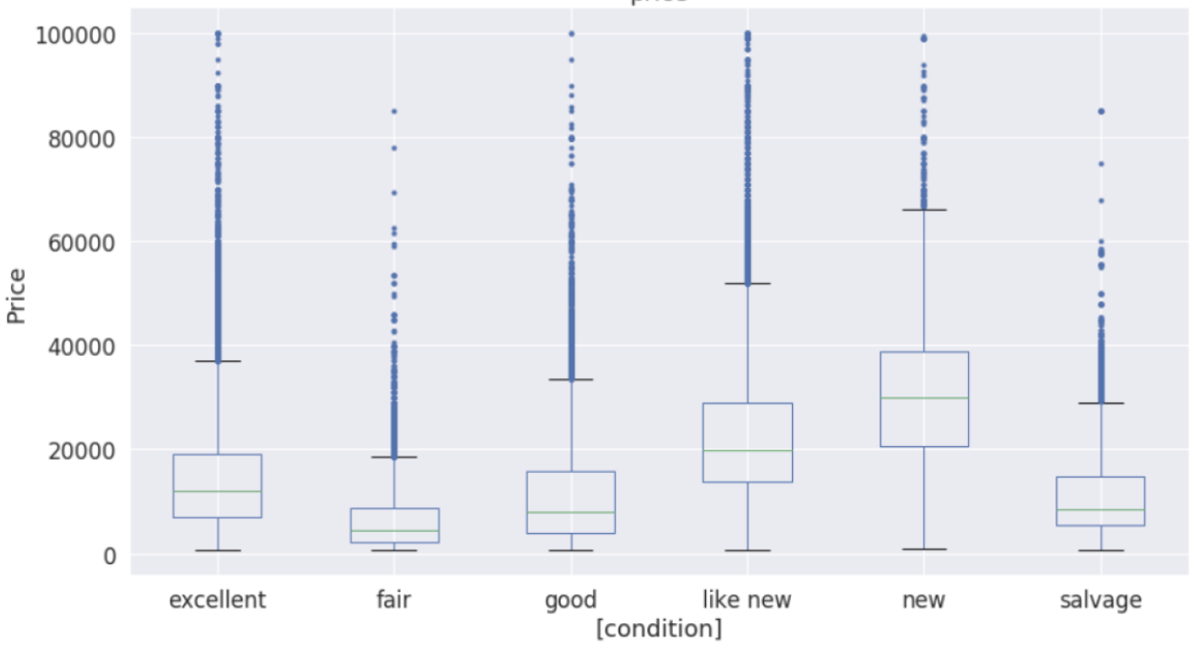
Visualize Relationships

Slide 85
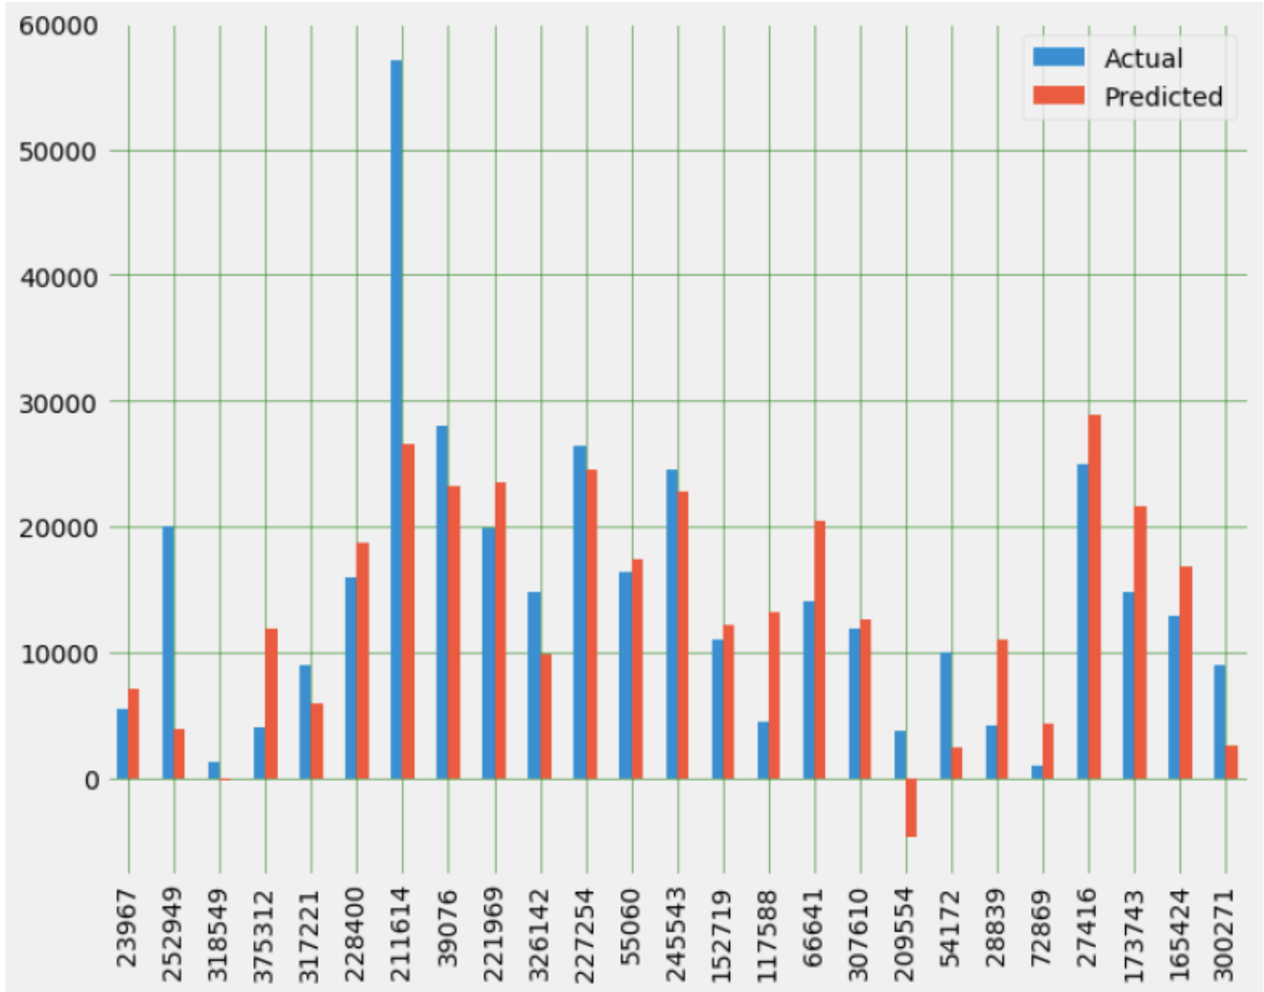
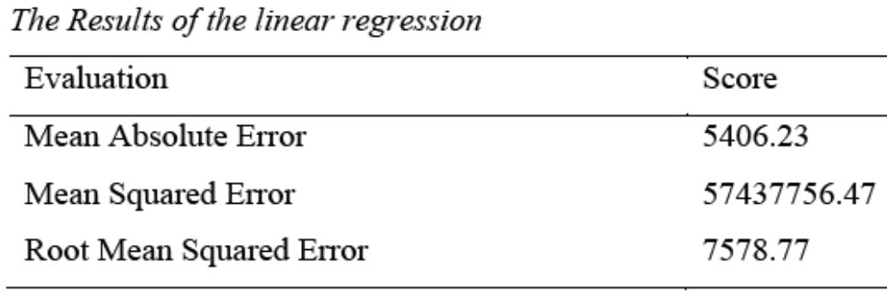
Linear Regression Performance

Slide 86
Case Study: Used Cars
Notes:
Q: [True/False] MAE for car price prediction could be improved simply by clipping negative predictions to 0.
A: True

